Slide 1
MALICIOUS SERVER HACK
Presented By:
Sharvaani - BL.EN.U4CSE20156
Shruti P - BL.EN.U4CSE20157
Suraj Gopinath - BL.EN.U4CSE20169
Tanuja K - BL.EN.U4CSE20174

Slide 2
INTRODUCTION
Malicious hacking of servers is the method of actively working to disable
security systems with an intention of stealing information and taking down
the system.
Malicious server hacks are very common these days and are a threat to any organization.
This model is used to predict if a system can be hacked given various
feature values.

Slide 3
DATA PREPROCESSING
Data preprocessing can refer to manipulation or dropping of data before it is used in order to ensure or enhance performance
Replace NaN with median
String to numeric conversion

Slide 4
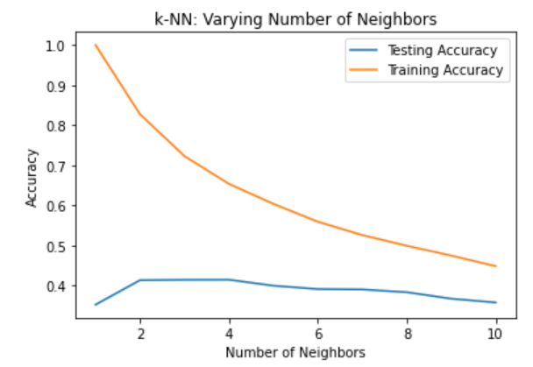

K NEAREST NEIGHBOUR
KNN is a supervised machine learning algorithm that can be used to solve both classification and regression problems
The time taken and accuracy for our dataset
is as mentioned below:

Slide 5
MULTI LAYER PERCEPTRON
A multilayer perceptron (MLP) is a feedforward artificial neural network that generates a set of outputs from a set of inputs.
Accuracy is as follows:

Slide 6




SUPPORT VECTOR MACHINE
Support Vector Machine(SVM) is a supervised machine learning algorithm used for both classification and regression.
Types of kernels used with accuracies and time taken:
Linear-
Polynomial-
Radial Basis Function-
Sigmoid-

Slide 7
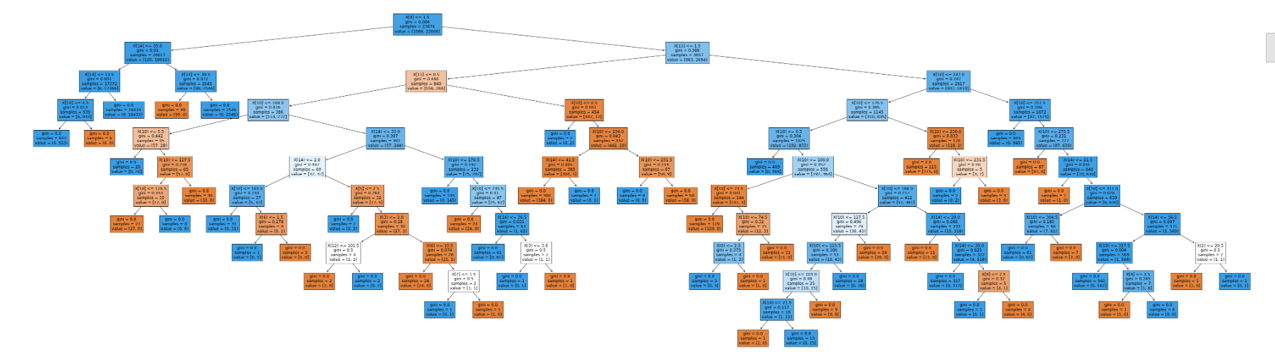

DECISION TREE
Used to categorize or make predictions based on how a previous set of questions were answered

Slide 8

NAIVE BAYES
Naïve Bayes is a simple learning algorithm that utilizes Bayes rule together with a strong assumption that the attributes are conditionally independent, given the class.

Slide 9

XGBoost
XGBoost is an implementation of Gradient Boosted decision trees.The weight of variables predicted wrong by the tree is increased and these variables are then fed to the second decision tree.
XGBoost accuracy:

Slide 10
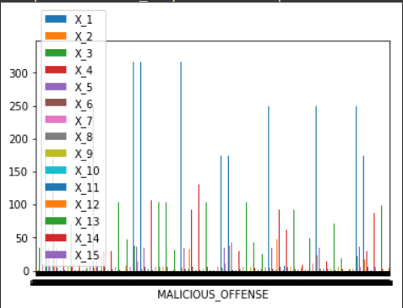

RANDOM FOREST
Random forests or random decision forests is an ensemble learning method for classification, regression and other tasks that operates by constructing a multitude of decision trees at training time. For classification tasks, the output of the random forest is the class selected by most trees. For regression tasks, the mean or average prediction of the individual trees is returned. Random decision forests correct for decision trees' habit of overfitting to their training set.
RF accuracy:

Slide 11

GAUSSIAN NAIVE BAYES
Gaussian Naive Bayes is a probabilistic classification algorithm based on applying Bayes' theorem with strong independence assumptions.. It assumes that the class conditional densities follow normal distribution.
The accuracy and time taken are as follows:

Slide 12
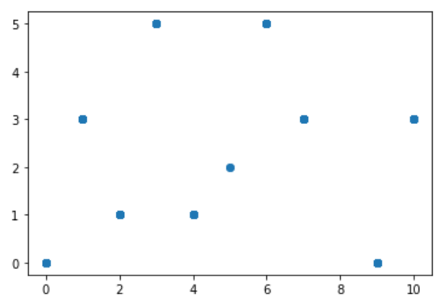
LINEAR REGRESSION
Linear regression analysis is used to predict the value of a variable based on the value of another variable.

Slide 13

LOGISTIC REGRESSION
Logistic regression estimates the probability of an event occurring, based on a given dataset of independent variables. Since the outcome is a probability, the dependent variable is bounded between 0 and 1.

Slide 14
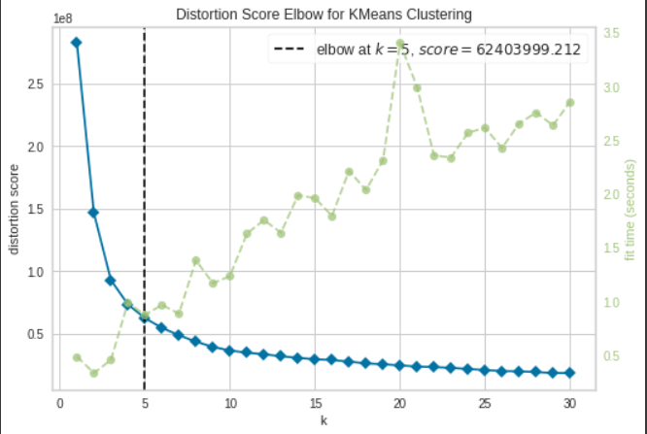
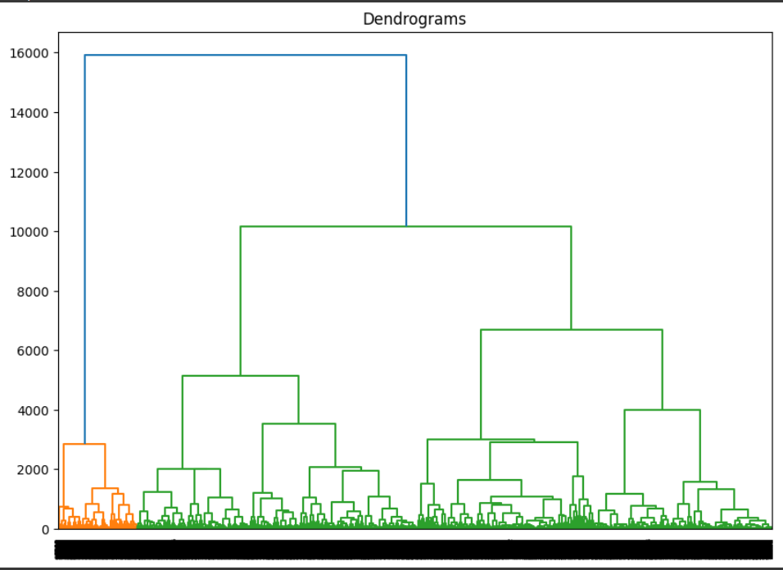
K MEANS CLUSTERING
Elbow Method
Hierarchical Clustering

Slide 15
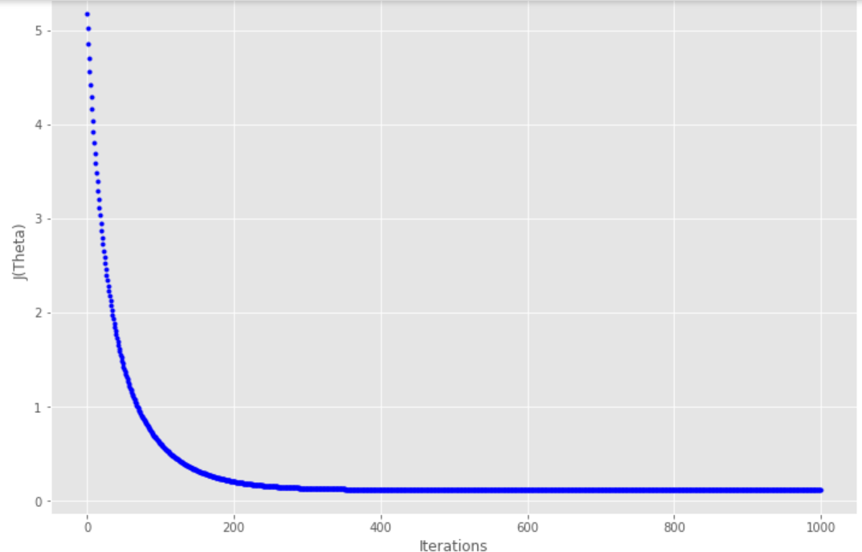
GRADIENT DESCENT
Gradient Descent is known as one of the most commonly used optimization algorithms to train machine learning models by means of minimizing errors between actual and expected results.

Slide 16
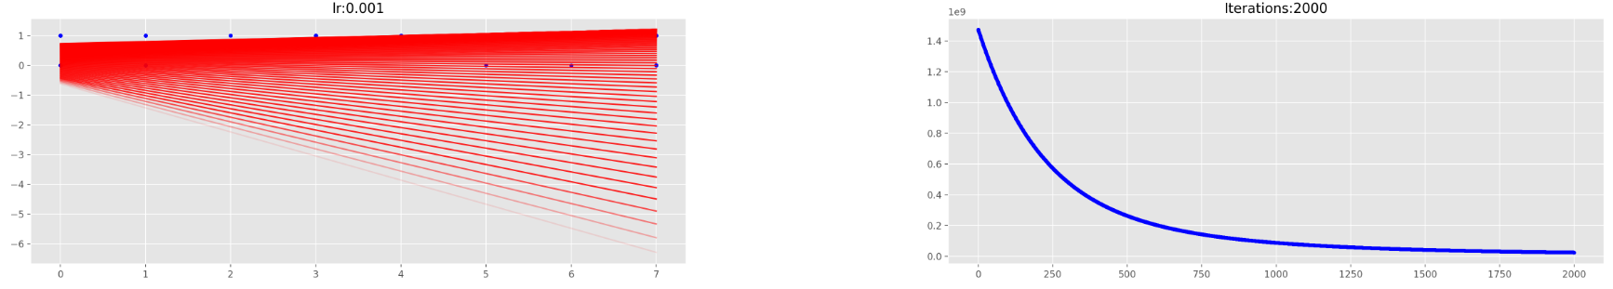
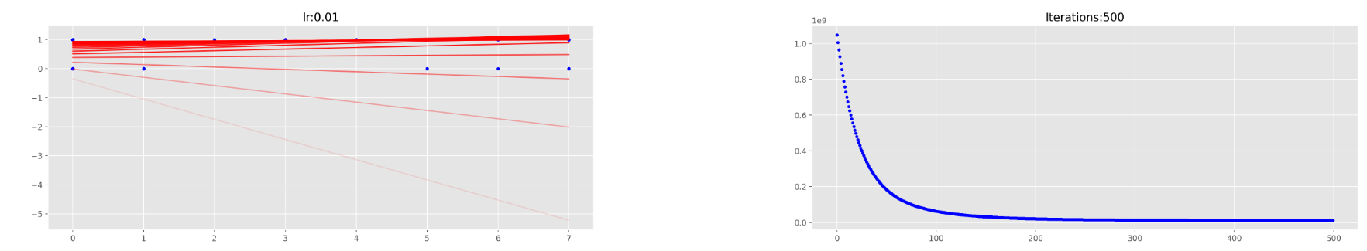
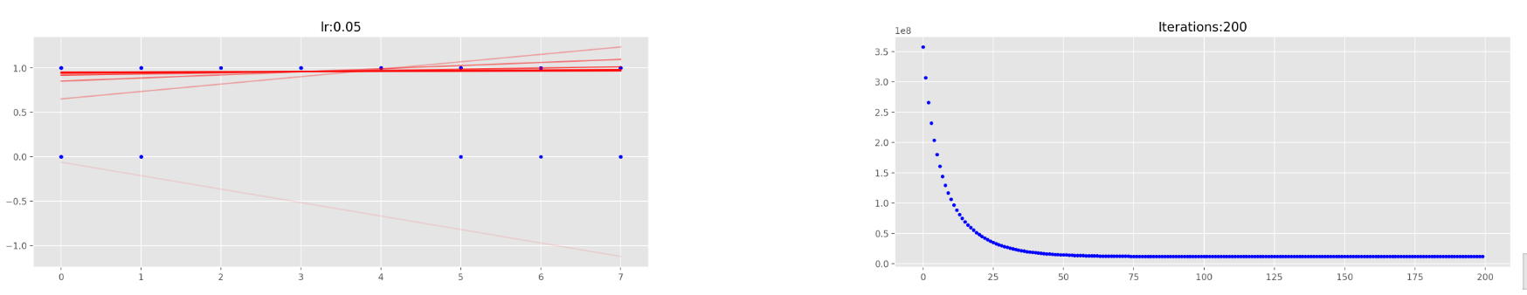
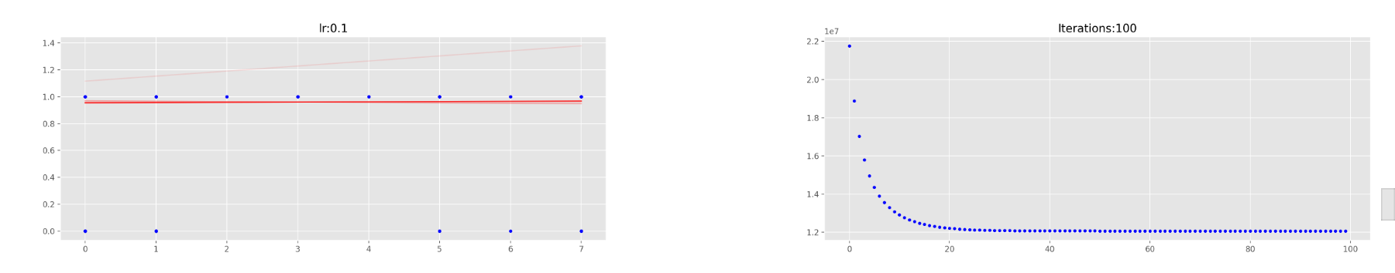

Slide 17
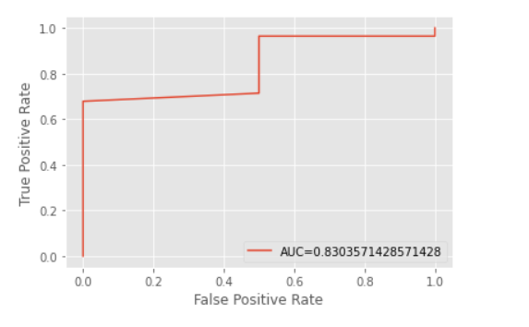
ROC
ROC or Receiver Operating Characteristic plot is used to visualise the performance of a binary classifier.

Slide 18
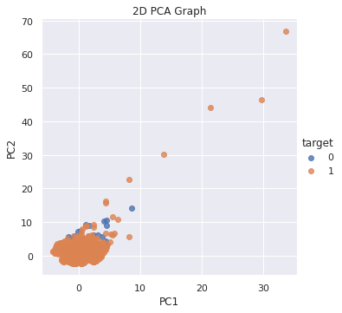
PCA
Principal Component Analysis (PCA) is a linear dimensionality reduction technique that can be utilized for extracting information from a high-dimensional space by projecting it into a lower-dimensional subspace.

Slide 19
ACCURACY MEASURES
The output from a classifier might not always give the same value. So, we use various accuracy measures like Precision,Recall, F Score to get better results.
Accuracy measures how close results are to the true or known value.
Precision, on the other hand, measures how close results are to one another

Slide 20
PLOTS
Plots help us to visualize data better in an easier manner.
The plot of accuracy plots each classifiers accuracy against each other.
The plot of time plots each classifiers time against each other.
This way, we can easily compare various classifiers.

Slide 21
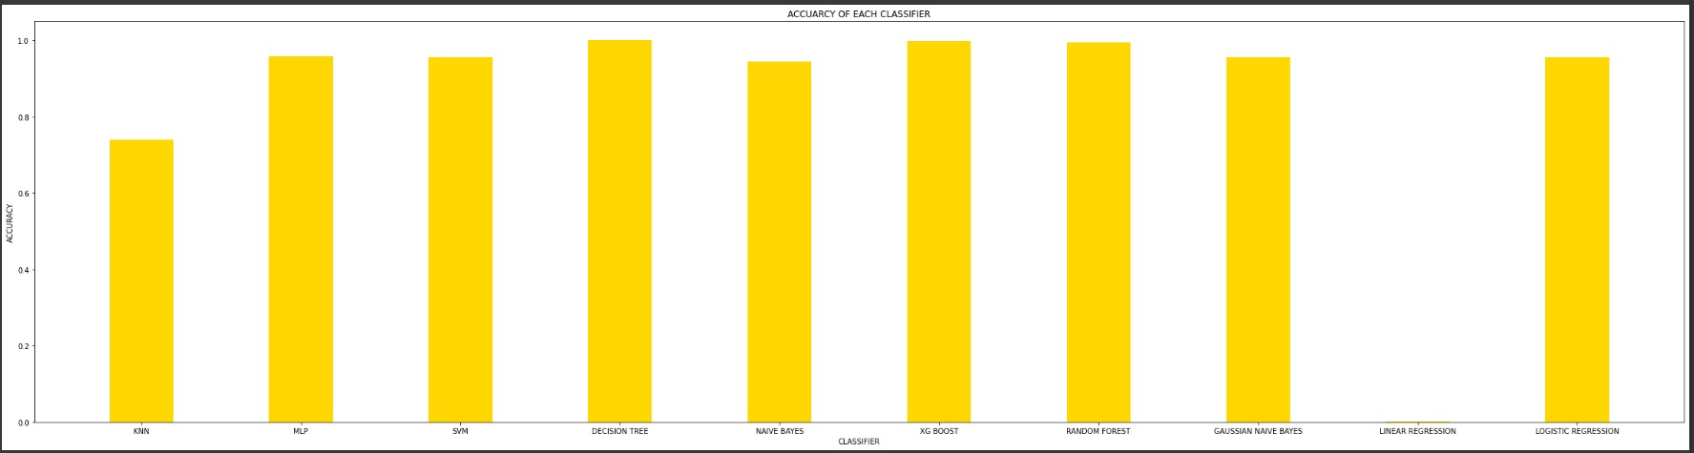
GRAPH OF ACCURACY

Slide 22
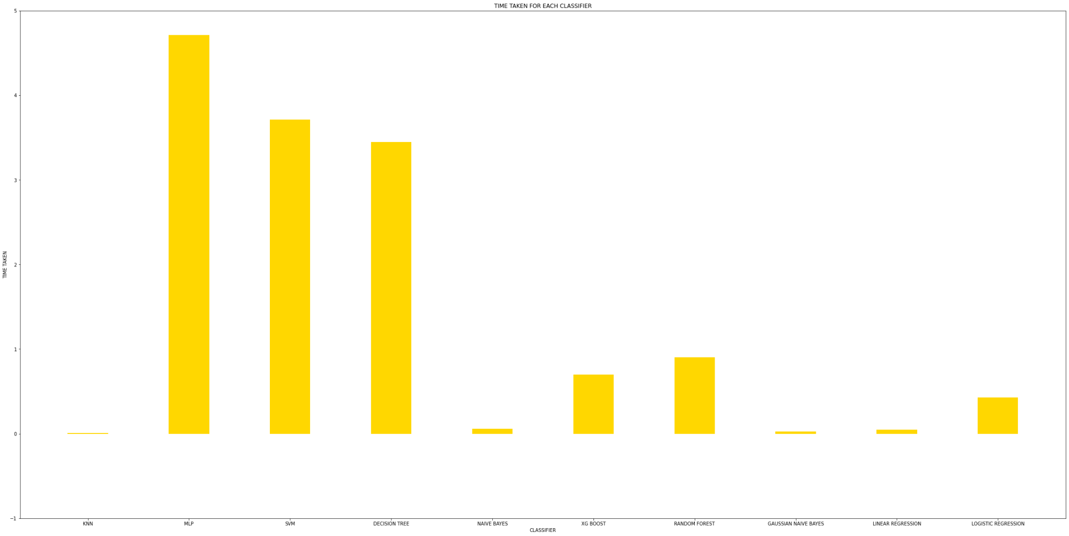
GRAPH OF TIME TAKEN

Slide 23
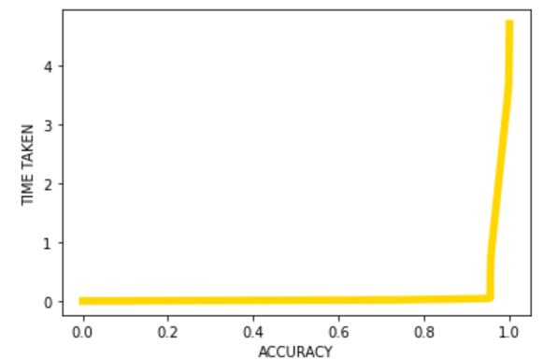
GRAPH OF ACCURACY VS TIME TAKEN

Slide 24
THANK
YOU

